Slide 1
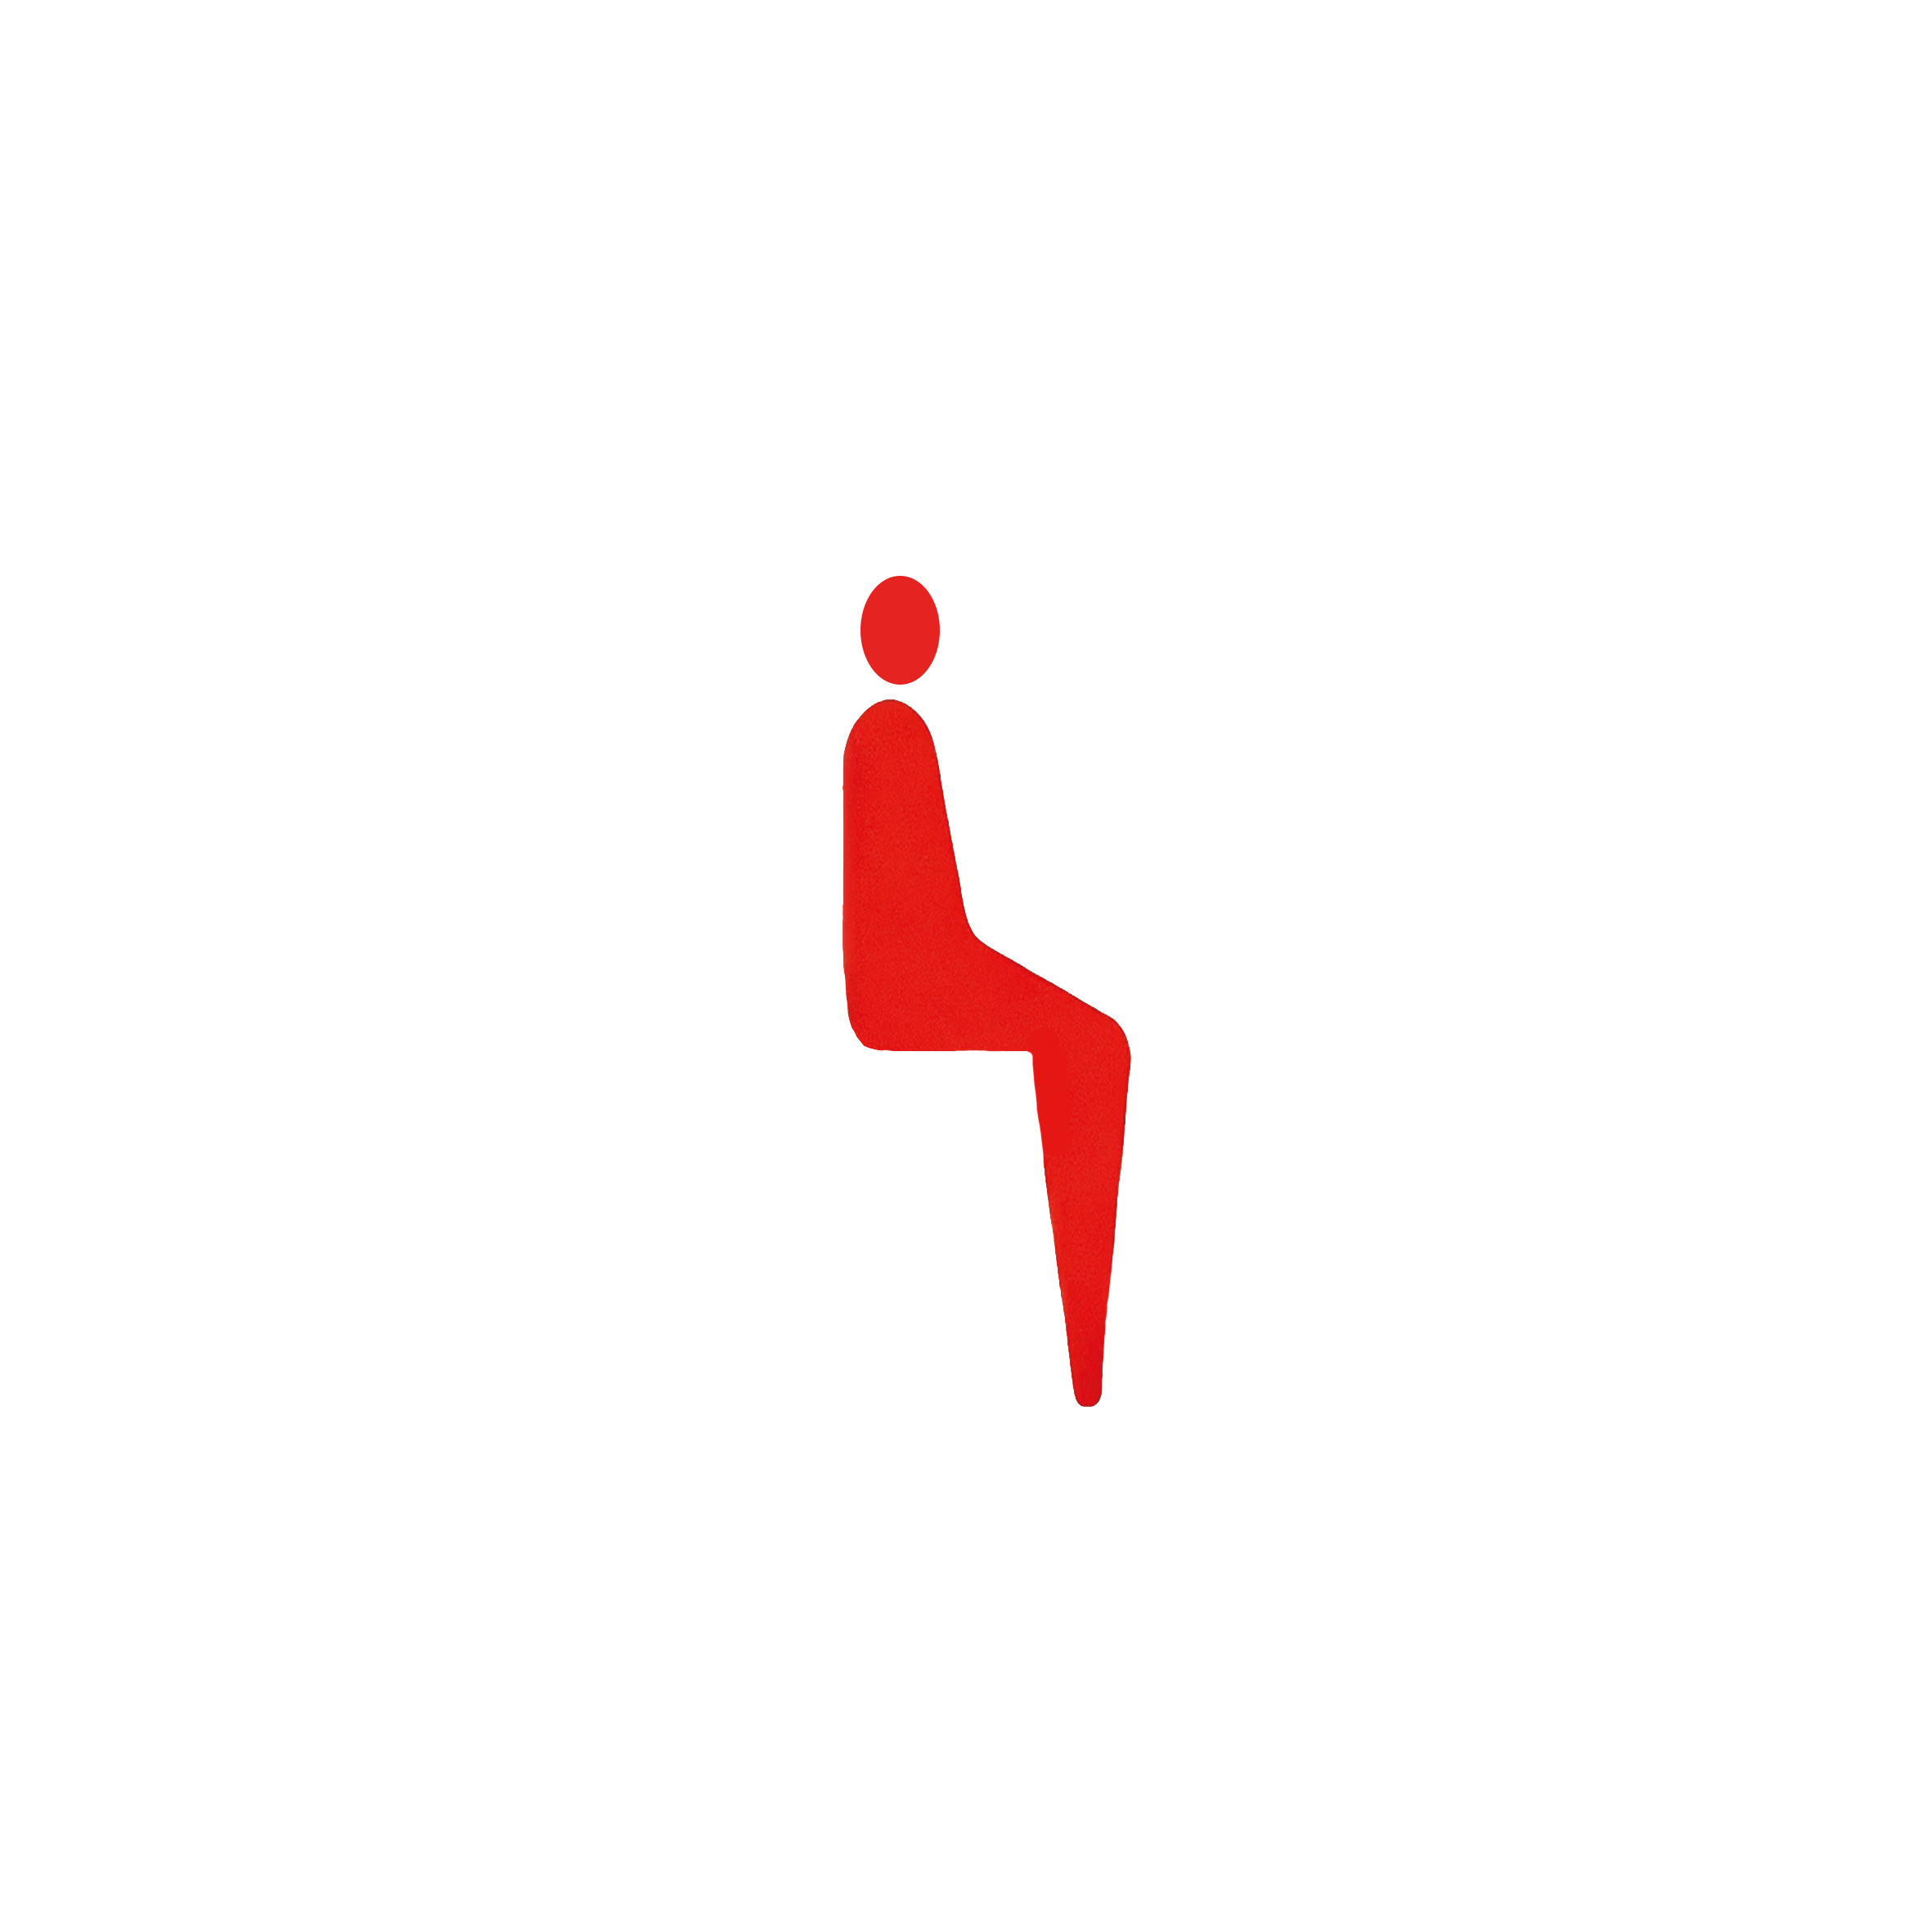
POSE FIX

Slide 2
POSE FIX

Slide 3
POSEFIXI

Slide 4
POSEFIXI
POSEFIX

Slide 5

POSEFIXI
POSEFIX

Slide 6

POSEFIX

Slide 7
POSEFIX

Slide 8
POSEFIX

Slide 9

POSEFIX

Slide 10
STRENGTHS: User Experience: User feedback as a frame following a traffic light scheme is intuitive and user-friendly Technology Stack: Advanced and secure technology Strategic Partnerships: Collaborations with other tech companies, platforms or health organizations Compliance with Privacy Laws: Adherence to GDPR, CCPA, etc. Trust and Transparency: Open communication about data privacy Sophisticated Monitoring: tracking performance, user behavior, etc. | WEAKNESSES: Lack of business experience Limited resources: Budget constraints, small team, etc. Scalability issues unknown: may be challenging to handle increased users or data Technical issues unknown: may encounter bugs, slow performance...more testing to be done Marketing strategy: Limited reach due to limited resources Dependency on Third-Party Platforms: For example, reliance on app stores which might limit expansion or control User Concerns about Privacy: Potential user skepticism or resistance to ergonomic video monitoring
OPPORTUNITIES: Technological advancements: Leveraging new lightweight models, better packages, etc. Regulatory changes: Stricter workplace regulation laws or policies Partnerships or alliances with health insurances Integration Possibilities: Opportunities to integrate with other apps, platforms, or services Innovative Privacy Solutions: Developing new ways to safeguard user data while maintaining functionality Adding new features and growing into other markets, e.g. ergonomic monitoring of manual labor, physiotherapy, and workout | THREATS: Competitive Market: similar offerings or big tech companies adapting our product and adding it on operating system level or within an office suite (e.g. Microsoft 365) Regulatory Challenges: EU AI Act could impose restrictions or require costly compliance measures Changes in consumer preferences: Increasing skepticism towards AI, less remote work or also a cultural development towards less long-term health orientation Economic Downturns: Which could impact funding or consumer spending Public Perception and Trust Issues: Perceived (or real) privacy concerns
S
W
O
T

